Slide 1


STROKE
-TEAM 4-
RISK FACTOR ANALYSIS

Slide 2


Introduction
Meet Bob...............................................................1
Stroke Statistics...................................................2
Objectives of the Study.......................................3
Overview of Data Variables
Visualization of Data............................................5
Data Pre-Processing
Cleansing, Transforming, Balancing...................6
Previous/New Applications..................................7
Predictive Modeling
Log Regression.....................................................8
KNN.......................................................................9
Decision Trees....................................................10
Random Forest....................................................11
Neural Networks.................................................12
Conclusion
Recommendation................................................13
TABLE OF CONTENTS

Slide 3
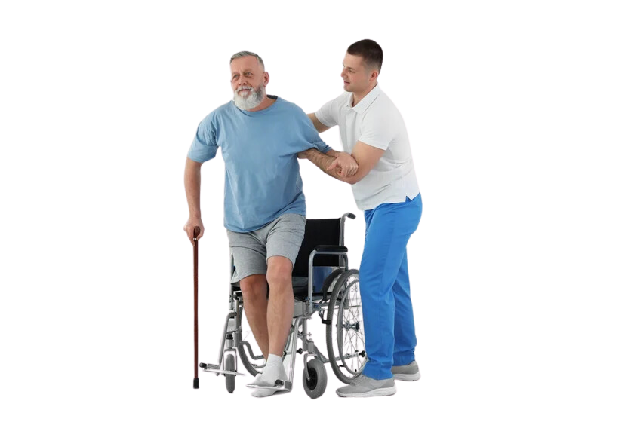


01
THIS IS BOB
Bob is among the 795,000 Americans who experienced a stroke in 2022. While he has survived this medical event, it has led to a lasting disability. Bob's 56 years old and his medical background reveals a history of diabetes, hypertension, hypercholesterolemia, and obesity. We will later discuss Bob's case and determine the ability of early detection so that preventive measures could have averted this outcome.

Slide 4


STROKE STATISTICS
High blood pressure, high cholesterol, smoking, obesity, and diabetes are leading causes of stroke.
Every
A stroke is the nation’s
3 minutes
14 seconds
No. 5
killer and a leading cause of serious long-term disability
1 in 3
someone dies from a stroke
U.S. adults has at least one of these conditions or habits.
02
Notes:
https://www.cdc.gov/stroke/facts.htm

Slide 5


Early prediction of stroke risk based on health indicators can significantly enhance preventive measures and patient outcomes. The goal of this study is to develop and validate the performance of predictive models that can accurately identify the risk of stroke in individuals based on their health data.
OBJECTIVES OF THE STUDY
03

Slide 6
Introduction
Meet Bob...............................................................1
Stroke Statistics...................................................2
Objectives of the Study.......................................3
Overview of Data Variables
Visualization of Data............................................5
Data Pre-Processing
Cleansing, Transforming, Balancing...................6
Previous/New Applications..................................7
Predictive Modeling
Log Regression.....................................................8
KNN.......................................................................9
Decision Trees....................................................10
Random Forest....................................................11
Neural Networks.................................................12
Conclusion
Recommendation................................................13
TABLE OF CONTENTS

Slide 7
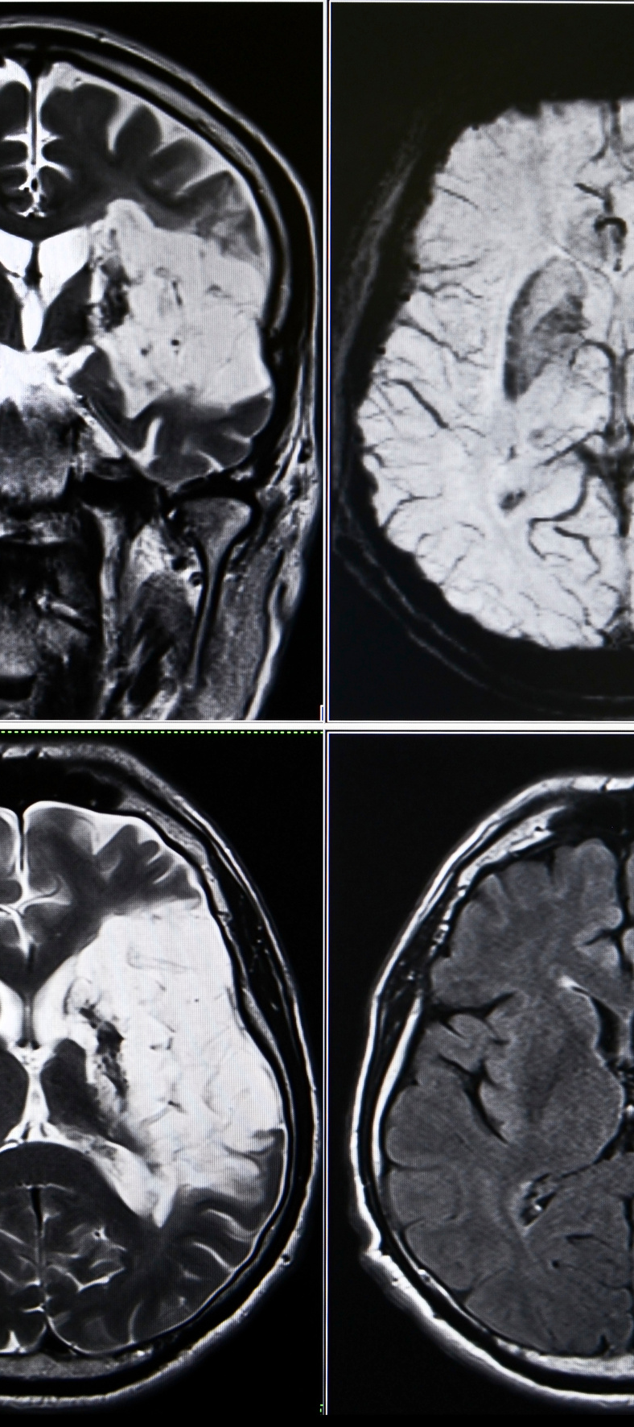


OVERVIEW OF DATA VARIABLES
The dataset includes variables such as age, gender, hypertension, glucose levels, bmi, smoking status, and work type, crucial for analyzing stroke risk factors.
Understanding how these factors interact can provide insights for stroke prevention strategies.
VISUALIZATION OF DATA
EXPLORATORY DATA ANALYSIS
04

Slide 8
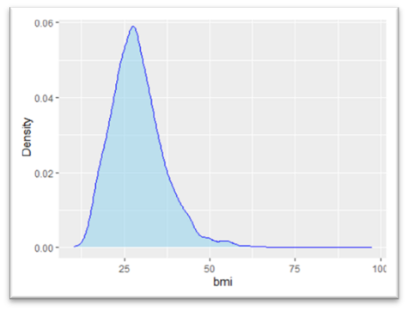
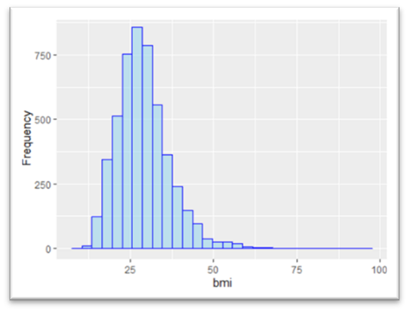
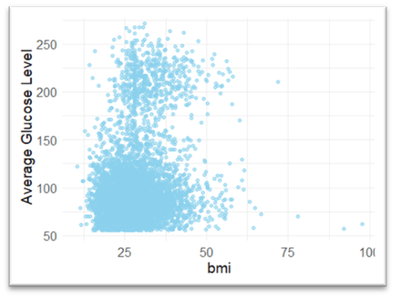
05
VISUALIZATION OF DATA
BMI
BMI vs Glucose Levels
Right-skewed distribution
Median used for NA values to better reflect underweight, overweight, and obesity prevalence
Healthy = BMI is 18.5-24.9; glucose under 140mg/dL
BMI over 25 correlates with higher average glucose levels

Slide 9
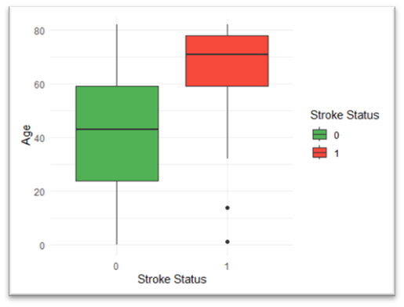
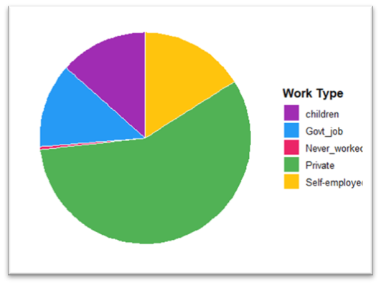
Age by Stroke Status
VISUALIZATION OF DATA
Distribution of Work Types
Significant difference in median age between stroke and non-stroke groups.
This emphasizes age as a key risk factor, suggesting tailored prevention strategies based on age.
The distribution of work types in the data helps to understand how occupation impacts lifestyle and health behaviors, providing insights into indirect stroke risk factors for comprehensive risk profiling.
05-B

Slide 10
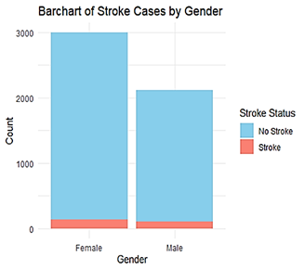
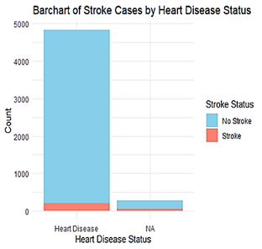
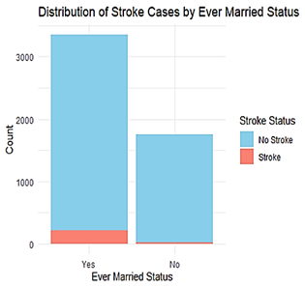
05-C
VISUALIZATION OF DATA
Bar charts Exploring Stroke Incidents Across Categorical Variables

Slide 11
Introduction
Meet Bob...............................................................1
Stroke Statistics...................................................2
Objectives of the Study.......................................3
Overview of Data Variables
Visualization of Data............................................5
Data Pre-Processing
Cleansing, Transforming, Balancing...................6
Previous/New Applications..................................7
Predictive Modeling
Log Regression.....................................................8
KNN.......................................................................9
Decision Trees....................................................10
Random Forest....................................................11
Neural Networks.................................................12
Conclusion
Recommendation................................................13
TABLE OF CONTENTS

Slide 12

DATA-PREPROCESSING
Data Cleaning: Removed irrelevant columns such as identifiers, converted categorical variables, and validated numerical variables. Missing categories and entries for 'Gender' and 'bmi' were addressed, with median imputation used for 'bmi' due to its right-skewed distribution.
Data Transformation: Min-max scaling in the dataset normalizes feature values to a [0, 1] range, ensuring variables of different scales have equal weight.
Class Balancing: 96% of data points had a stroke. Applied Synthetic Minority Over-sampling Technique (SMOTE) to address the imbalance in the stroke outcome variable.
06

Slide 13

PREVIOUS
NEW
Models utilizing basic statistical methods provided essential insights into how these well-known factors contributed to stroke risk
The study improves stroke risk analysis by using Neural Networks and SMOTE to address data imbalance.
SMOTE creates synthetic samples for the minority class, enhancing model performance by balancing class distribution.
This method leads to more accurate predictions of stroke risk.
REAL-WORLD APPLICATION
07

Slide 14
Introduction
Meet Bob...............................................................1
Stroke Statistics...................................................2
Objectives of the Study.......................................3
Overview of Data Variables
Visualization of Data............................................5
Data Pre-Processing
Cleansing, Transforming, Balancing...................6
Previous/New Applications..................................7
Predictive Modeling
Log Regression.....................................................8
KNN.......................................................................9
Decision Trees....................................................10
Random Forest....................................................11
Neural Networks.................................................12
Conclusion
Recommendation................................................13
TABLE OF CONTENTS

Slide 15
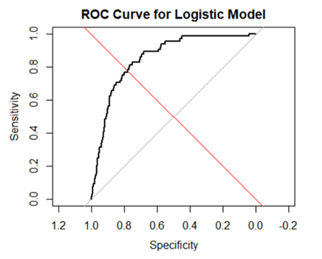
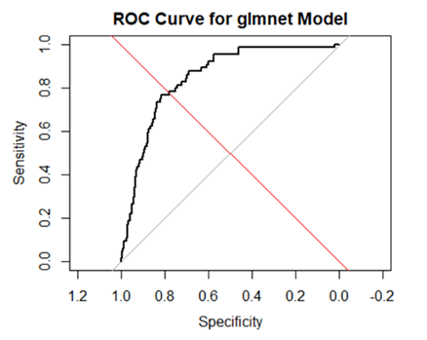
LOG REGRESSION
Logistic Regression had an accuracy of 71.4%.
Regularized with glmnet to address limitations like overfitting and multicollinearity
Showed similar performance, glmnet accuracy was 71.24%.
ROC analysis demonstrated comparable performance for both models, indicating that regularization did not significantly improve predictive capability.
09

Slide 16
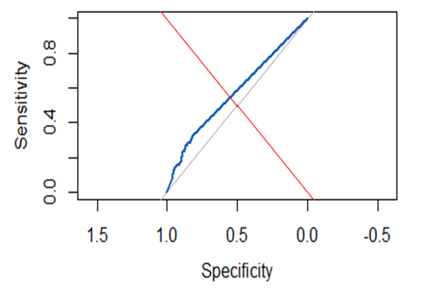
K-NEAREST NEIGHBORS
The KNN model achieved 79.5% accuracy in predicting stroke risk by tuning the number of neighbors to k=5 and standardizing data.
The ROC analysis showed limited discriminatory power, with the model struggling to differentiate between patients at risk of stroke and those not at risk.
10

Slide 17
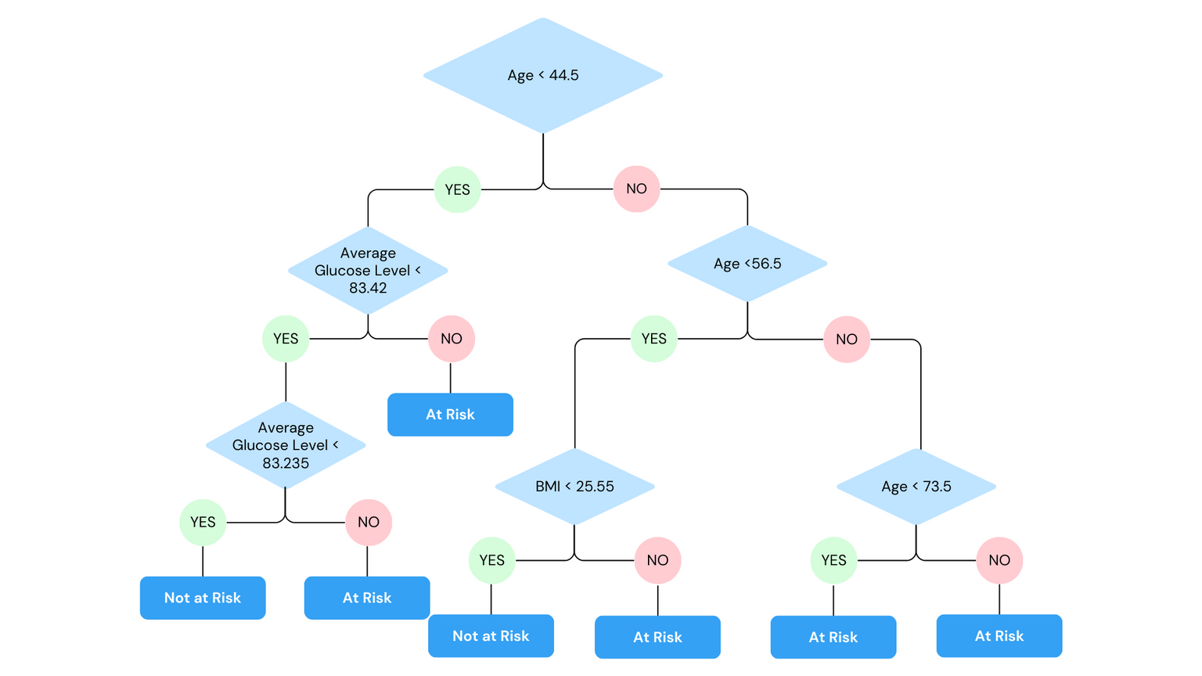

Fine-tuned tree depth to optimize performance and prevent overfitting. Confusion matrix showed model strengths and areas for improvement, with an accuracy rate of around 58.6%.
Decision tree analysis highlighted age as a pivotal condition, leading to different pathways based on specific criteria like glucose levels and BMI.
DECISION TREE
11

Slide 18
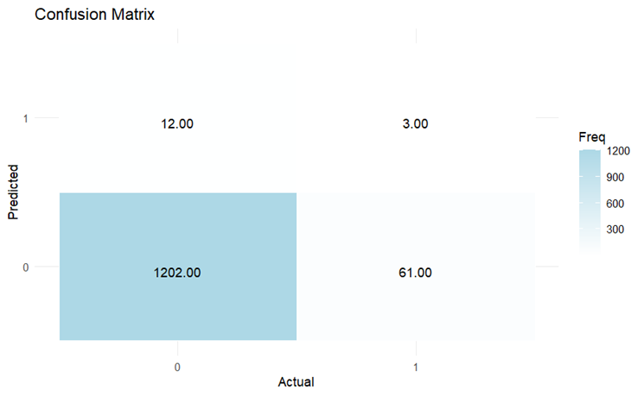
RANDOM FOREST
By aggregating predictions from 100 trees, it achieved 94.0% accuracy.
Calibration involved adjusting tree numbers and depths for optimal performance and reliability across patient profiles.
Its ability to mitigate bias and variance makes it ideal for clinical applications like stroke detection and prevention.
12

Slide 19
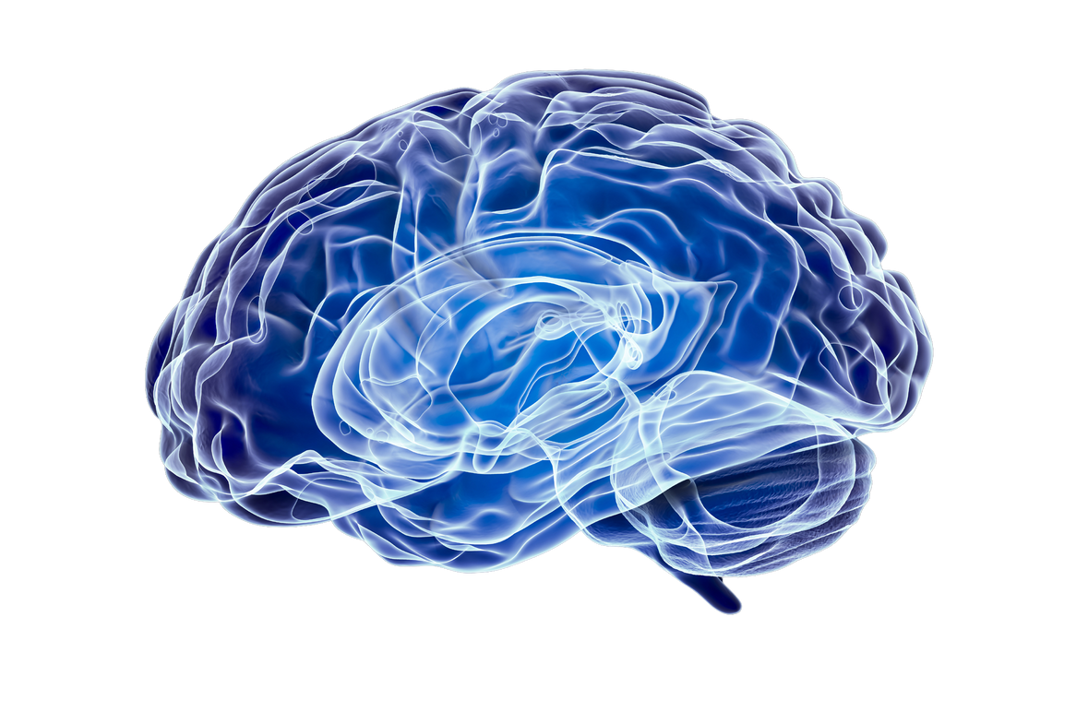
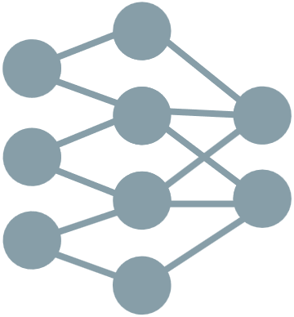
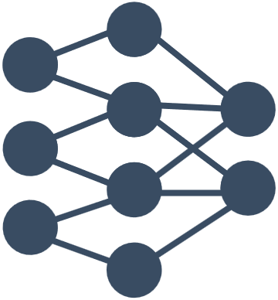


NEURAL NETWORK
Neural networks mimic the brain's processing. Accuracy of about 91%.
Each neuron is linked to a weight and bias.
Backward propagation
Excels in modeling nonlinear relationships in data thanks to activation functions like ReLU and sigmoid.
09

Slide 20
Introduction
Meet Bob...............................................................1
Stroke Statistics...................................................2
Objectives of the Study.......................................3
Overview of Data Variables
Visualization of Data............................................5
Data Pre-Processing
Cleansing, Transforming, Balancing...................6
Previous/New Applications..................................7
Predictive Modeling
Log Regression.....................................................8
KNN.......................................................................9
Decision Trees....................................................10
Random Forest....................................................11
Neural Networks.................................................12
Conclusion
Recommendation................................................13
TABLE OF CONTENTS

Slide 21
13
RECOMMENDATION
Advocate for integrating the Random Forest model in clinical practice due to its performance and compatibility.
Emphasize data relevance over complexity for model success.
Suggest continuous data collection and training to align with dynamic health trends.

Slide 22
THANK YOU
QUESTIONS
-TEAM 4-

